Slide 1
Research proposal

Slide 2
What is your research proposal used for and why is it important?
It is used to establish whether there is expertise to support your proposed area of research
It forms part of the assessment of your application
The research proposal you submit as part of your application is just the starting point, as your ideas evolve your proposed research is likely to change

Slide 3
How long should my research proposal be?
It should be 2,000–3,500 words (4-7 pages) long.
What should be included in my research proposal?
Your proposal should include the following:
1. TITLE
2. BACKGROUND AND RATIONALE
3. RESEARCH QUESTION(S)
4. RESEARCH METHODOLOGY
5. PLAN OF WORK & TIME SCHEDULE
6. BIBLIOGRAPHY

Slide 4
1. TITLE
Your title should give a clear indication of your proposed research approach or key question
2. BACKGROUND AND RATIONALE
You should include:
the background and issues of your proposed research
identify your discipline a short literature review
a summary of key debates and developments in the field

Slide 5
. RESEARCH QUESTION(S)
You should formulate these clearly, giving an explanation as to what problems and issues are to be explored and why they are worth exploring
RESEARCH METHODOLOGY
You should provide an outline of:
the theoretical resources to be drawn on
the research approach (theoretical framework).
the research methods appropriate for the proposed research
a discussion of advantages as well as limits of particular approaches and methods

Slide 6
PLAN OF WORK & TIME SCHEDULE
You should include an outline of the various stages and corresponding time lines for developing and implementing the research, including writing up your thesis.
For full-time study your research should be completed within three years, with writing up completed in the fourth year of registration.
For part-time study your research should be completed within six years, with writing up completed by the eighth year.
BIBLIOGRAPHY
You should include:
a list of references to key articles and texts discussed within your research proposal
a selection of sources appropriate to the proposed

Slide 7
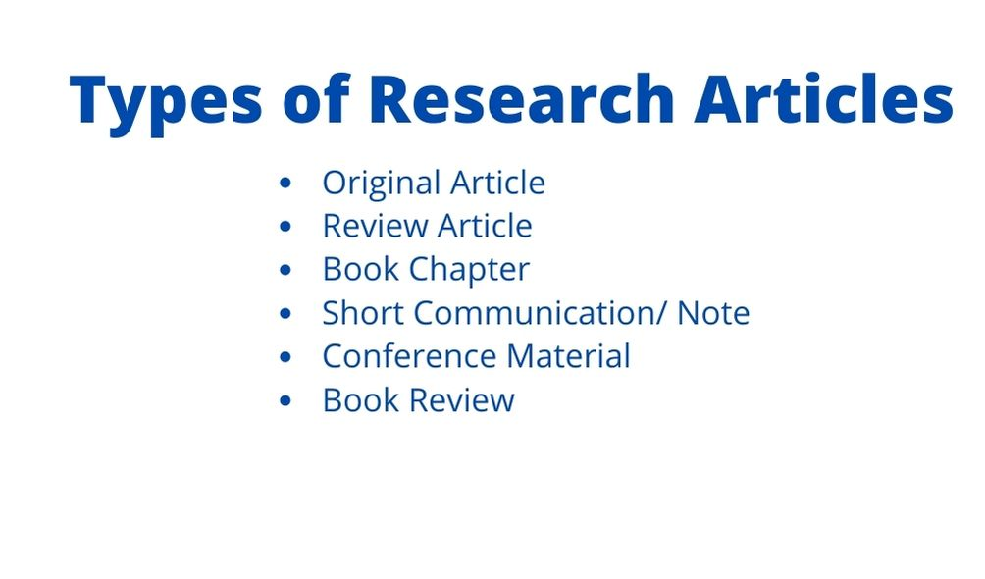

Slide 8
A Short Communication is intended for the presentation of brief observations that do not warrant a full-length paper.
Short communication should be submitted the same way as a full-length paper.
The Short Communication manuscript in general:
Total length should not exceed 10 double lined standard pages including illustrative material (in total no more than 3 figures and tables)
Each Short Communication must have an Abstract limited to 100 words
Manuscript should be formatted without section headings in the body of the text
All the required parts (Introduction, Materials & Methods, Results and Discussion) except for the Literature must be given in single section
Should be typed in 12 points Times New Roman font
No part of the manuscript should be underlined and written using capital letters

Slide 9
“Thesis” and “dissertation” are sometimes used interchangeably, but their definitions differ per country.
In the US, a dissertation generally refers to the collection of research you conducted to obtain a PhD.
In other countries (such as the UK), a dissertation often refers to the research you conduct to obtain your bachelor’s or master’s degree.

Slide 10
How to write and structure a dissertation
Title page
Acknowledgements or preface
Certificate by supervisor
Abstract
Table of contents
List of figures and tables
List of abbreviations
Glossary (a list of special or unusual words and their meanings, usually at the end of a text or book)

Slide 11
Introduction
Literature review
Methodology
Results
Discussion
Conclusion
Reference list
Appendices
Proofreading and editing

Slide 12
Unit 5
(IPR)

Slide 13
Intellectual property rights (IPR)
refers to the legal rights given to the inventor or creator to protect his invention or creation for a certain period of time. These legal rights confer an exclusive right to the inventor/creator or his assignee to fully utilize his invention/creation for a given period of time.

Slide 14
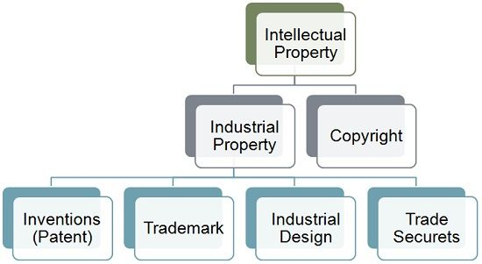

Slide 15
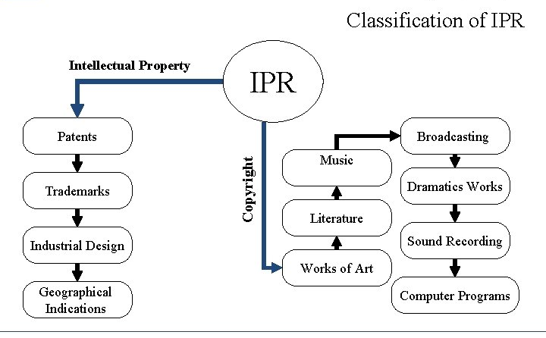

Slide 16
1. Patents:
A patent in the law is a property right and hence, can be gifted, inherited, assigned, sold or licensed. The patent right is territorial in nature and inventors/their assignees will have to file separate patent applications in countries of their interest, along with necessary fees, for obtaining patents in those countries .
2. Trademarks
Popularly known as brand name in layman’s language, is a visual symbol which may be a word signature, name, device, label, numerals or combination of colours used by one undertaking on goods or services or other articles of commerce to distinguish it from other similar goods or services originating from a different undertaking .

Slide 17
3. Designs
Design means the features of shape, configuration, pattern or ornament or composition of lines or colour or combination thereof applied to any article whether two dimensional or three dimensional or in both forms, by any industrial process or means, whether manual, mechanical or chemical, separate or combined .
4. Copyrights
Copyright is a right given by the law to creators of literary, dramatic, musical and artistic works and producers of cinematograph films and sound recordings. It is a bundle of rights including, interalia, rights of reproduction, communication to the public, adaptation, and translation of the work

Slide 18
Geographical Indications
A geographical indication (GI) is a sign used on products that have a specific geographical origin and possess qualities or a reputation that are due to that origin.
Plant Varieties
To accelerate agricultural development, it is necessary to protect plants breeders’ rights to stimulate investment for research and development for the development of new plant varieties. Simultaneously, it is helpful for the seed industry to ensure availability of high quality of seeds to the farmers

Slide 19
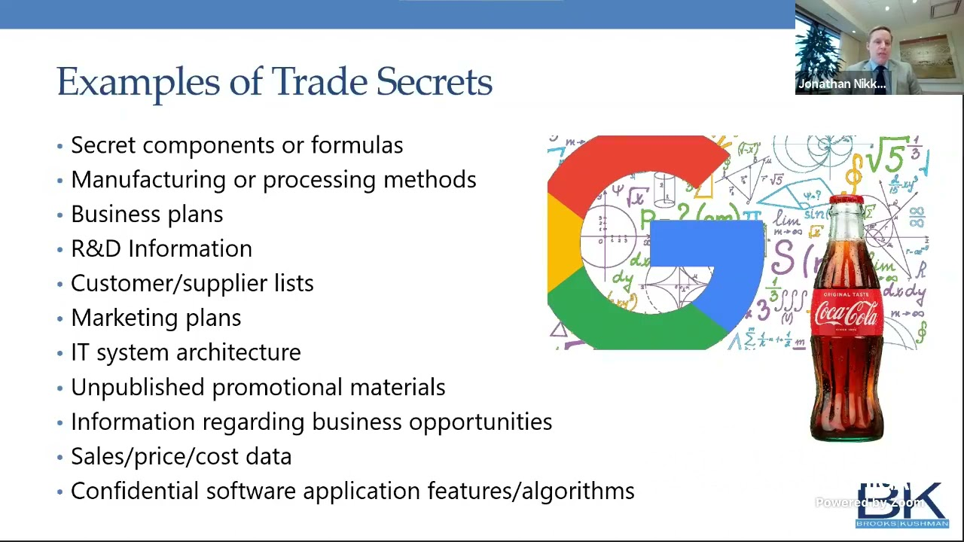

Slide 20
